Slide 1

Rapid Response System
Quick Courier Service
Guided By:
Dr. R. Sumathi
(Assistant Professor)

Slide 2
Team Details
S. No. | Name | Reg. No.
1 | H. Dheeraj Kishore | 99220040269
2 | G. Hemanandan Reddy | 99220040265
3 | T. Akash Reddy | 99220040209
4 | G. Geetha Vinay Krishna | 99220040267
5 | T. Girish Swamy | 99220040207

Slide 3
Contents
01
Problem Statement
02
Abstarct
03
Objectives
04
Literature Survey
05
Methodology
06
Modules
07
Dataset
08
Implementation
09
Conclusion
10
References

Slide 4
Problem Statement
Problem Statement
The problem statement is to address inefficiencies and delays in traditional parcel delivery services, where customers face extended waiting times and lack of transparency in route selection. There is a need for a solution that provides quick, optimized routes for parcel delivery, ensuring timely and cost-effective service.
Introduction
The "Quick Courier Service" is a web-based application designed to optimize courier deliveries by calculating the fastest and most efficient routes in real-time. It helps customers and delivery services minimize delays and improve overall delivery speed. The project focuses on enhancing efficiency and reliability in the courier industry.

Slide 5
Abstract
Background
Finding the quickest and shortest delivery routes is key for efficient courier services.
Many current systems use outdated methods, leading to inefficiencies.
Algorithm
Dijkstra’s Algorithm
Expected Outcome
The project will help deliver packages faster, save time and fuel, and improve customer satisfaction.

Slide 6
Objectives
Enhance delivery efficiency by identifying the shortest and fastest route for couriers between cities.
Provide dynamic cost estimates based on parcel weight, and vehicle type for customer convenience.
Enable real-time route selection through an interactive map interface showing optimal routes.
Streamline operations with an admin-only login for secure, restricted access to sensitive functionalities.
Reduce delivery times compared to the standard 3-day delivery period in India.

Slide 7
Literature Survey
S. No. | Title | Authors | Methodology | Research Gap
1 | GIS-Based optimum path analysis for tourist places in Haridwar City(September 2024) | Pankaj P. Tasgaonkar, Rahul Dev Garg & Pradeep Kumar Garg | The study uses a shortest path algorithm within a GIS framework to optimize route planning in Haridwar, considering time and distance as cost attributes. The analysis provides tourists with the most efficient routes to visit multiple locations in a single day. | Existing tourist route planning systems lack optimization for time and distance. This research addresses the gap by applying a GIS-based shortest path algorithm to enhance route efficiency in the holy city of Haridwar.
2 | Ship Path Planning Based on Sparse A* Algorithm ( April 2024) | Yongjian Zhai, Jianhui Cui, Fanbin Meng, Huawei Xie, Chunyan Hou & Bin Li | An improved sparse A* algorithm is developed for ship path planning, considering factors like ship position, orientation, safety, and draft. The method includes coordinate transformation and hierarchical chart processing for enhanced obstacle avoidance and optimal route generation. | Traditional path planning algorithms for ships neglect critical factors like ship status and excessive node expansion. This research addresses the gap by incorporating ship-specific parameters and optimizing grid size to improve efficiency and safety in maritime navigation.
3 | Study of Route-Finding Algorithms on the Transport System (February 2024) | Roman Surovtsev & Roman Dzerzhinsky | The study conducts a comparative analysis of Floyd-Warshall, Dijkstra, and A* algorithms in urban transportation systems using theoretical, computational, and empirical methods to evaluate their efficiency and stability. | Limited research exists comparing multiple route search algorithms in transportation systems. This study fills the gap by evaluating and refining the most efficient algorithm for urban route optimization.

Slide 8
Literature Survey
S. No. | Title | Authors | Methodology | Research Gap
4 | Agent-based decision-support model for bus route redesign in networks of small cities and towns: case study of Agder, Norway ( 2024) | Sinziana I. Rasca, Bin Hu, Benjamin Biesinger & Matthias Prandtstetter | An agent-based simulation tool, adapted from a Mobility as a Service model, is used to evaluate nine scenarios for optimizing a regional bus route in Agder, Norway. The model includes persona profiles tailored to the local commuting patterns to identify scenarios that maximize bus patronage while minimizing travel time and costs. | There is limited research on applying agent-based simulation tools for public transport planning in small cities and towns. This study fills the gap by adapting an urban-focused simulation model to assess transportation improvements in smaller regional networks.
5 | Path Optimization of e-Commerce Logistics Terminal Distribution Mode Based on Dijkstra Algorithm (June 2023) | Shuoyuan Lin | This study develops a distribution optimization model using the Dijkstra algorithm to minimize logistics costs in e-commerce terminal distribution. The hybrid tag search algorithm is applied to enhance the path optimization process. | Current e-commerce logistics systems lack efficient optimization for terminal distribution. This research addresses the gap by integrating Dijkstra and hybrid tag search algorithms to optimize last-mile delivery, reducing costs and improving efficiency.
6 | Design and Implementation of Intelligent Tourism System Based on Dijkstra Algorithm (April 2023) | Xifang Wang | The Intelligent Tourism System (ITS) is designed using the Dijkstra algorithm to find the shortest paths between tourist destinations. The system integrates a management system, decision support system. | Existing tourism systems lack efficient pathfinding algorithms for real-time route optimization. This study addresses the gap by incorporating the Dijkstra algorithm to improve decision-making and route management in tourism services.

Slide 9
Literature Survey
S. No. | Title | Authors | Methodology | Research Gap
7 | Implementing Robotic Path Planning After Object Detection in Deterministic Environments Using Deep Learning Techniques (January 2023) | R. Gayathri, V. Uma & Bettina O’Brien | This study utilizes a convolutional neural network (CNN) to identify obstacles and free space in a dynamic environment for local path planning. Three sampling-based path planning algorithms are then applied to generate optimal collision-free paths, with results compared based on time and distance efficiency. | Existing robotic path planning methods often struggle with dynamic environments. This research addresses this by integrating deep learning (CNN) for real-time obstacle detection and path optimization, enhancing the robot’s ability to navigate in constantly changing environments.
8 | .A path-based approach to analyzing the global liner shipping network (2022) | Timothy LaRock, Mengqiao Xu & Tina Eliassi-Rad | We develop a path-based approach to analyze liner shipping service routes, focusing on navigational trajectories that respect the sequential nature of the data while minimizing cargo transfers. This method is compared to other network representations to evaluate performance in terms of path length and nautical distance. | Previous studies have overlooked the sequential nature of liner shipping routes, limiting their ability to fully capture navigational efficiency. Our work addresses this by integrating route sequences into path computation, offering more industry-relevant insights.
9 | A second-order dynamic and static ship path planning model based on reinforcement learning and heuristic search algorithms (2022) | Junfeng Yuan, Jian Wan, Xin Zhang, Yang Xu, Yan Zeng & Yongjian Ren | A second-order ship path planning model is developed, combining Dyna-Sarsa(λ) for global path planning and FCC-A* for local path planning to reduce collision risks and improve planning efficiency. | Current methods struggle with slow planning speeds and low security, particularly in collision avoidance. This work addresses these issues with enhanced dynamic simulation and risk assessment techniques.

Slide 10
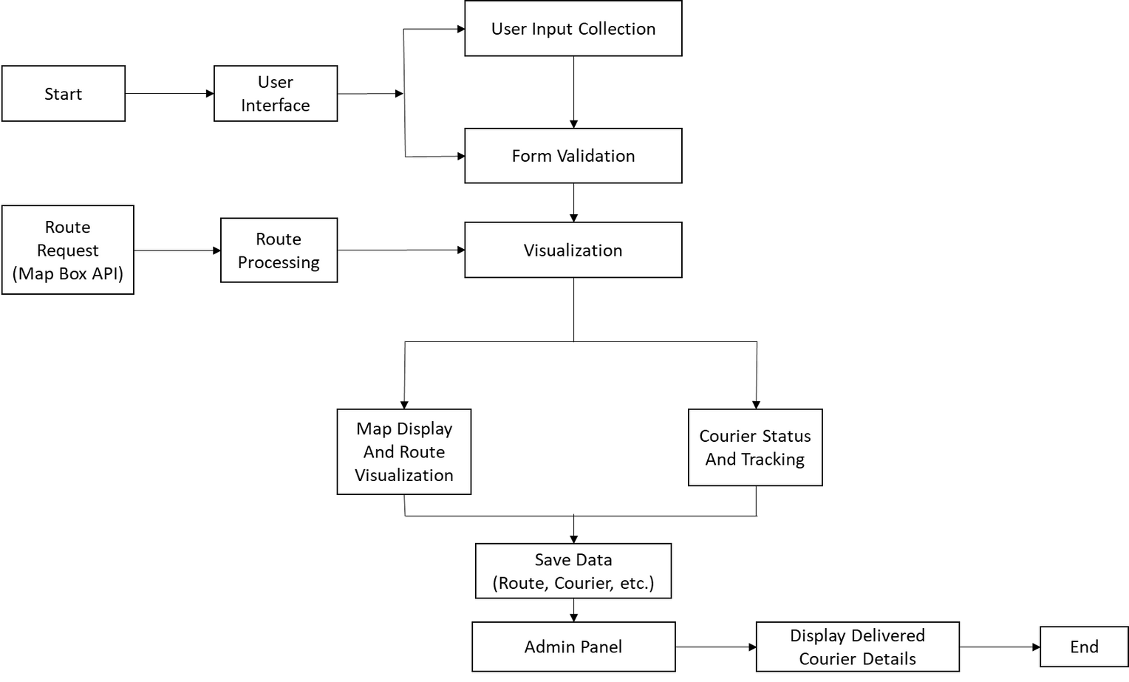
Methodology

Slide 11
Modules
User Input Module
Collects source and destination addresses from the user, ensuring proper validation and formatting of the input.
Route Calculation Module
Computes the shortest and most efficient route based on real-time factors, optimizing delivery times for couriers.
Map Visualization Module:
Displays the calculated route on an interactive map, showing distance, estimated delivery time and route details.

Slide 12
Dataset
The "Quick Courier Service" project primarily relies on real-time data instead of a static dataset. The data is fetched dynamically to calculate the best routes.
Routing and Navigation
The project utilizes a MAPBOX API to calculate real-time routes, ensuring that users receive the most efficient path from source to destination
Geolocation and Coordinates
For accurate mapping, city names are converted into latitude and longitude coordinates, enabling the service to pinpoint exact starting and ending locations for each delivery route.

Slide 13
Dataset
Interactive Map Display
An interactive map feature on the website lets users visually select source and destination locations, view routes, and assess the delivery path options.
Dynamic Route Data
By accessing updated route information, including distance and duration, the service provides reliable delivery time estimates and calculates costs based on real-time route options.
Optimized Delivery Experience
The map integration supports efficient navigation, helping customers choose the fastest and most cost-effective route to meet their delivery needs.

Slide 14
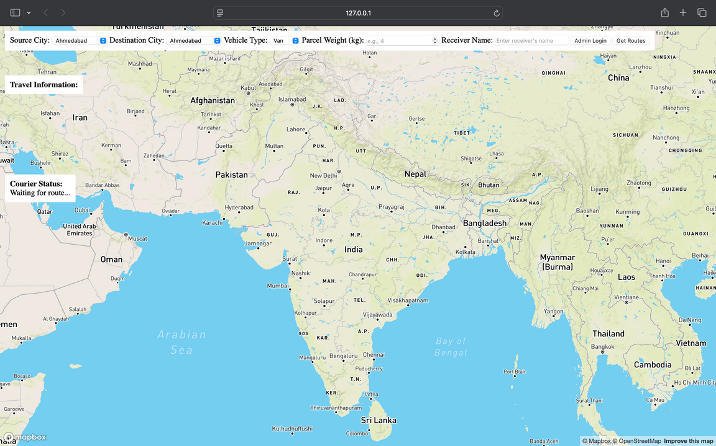
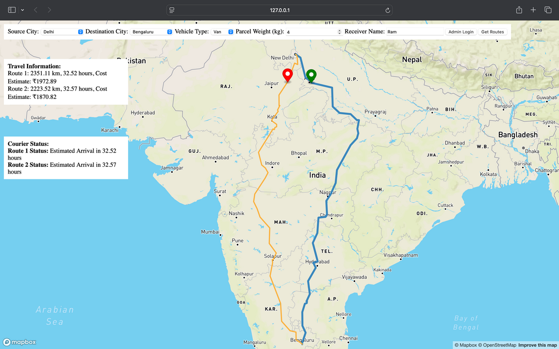
Implementation
Output Interface
Route Visualization

Slide 15
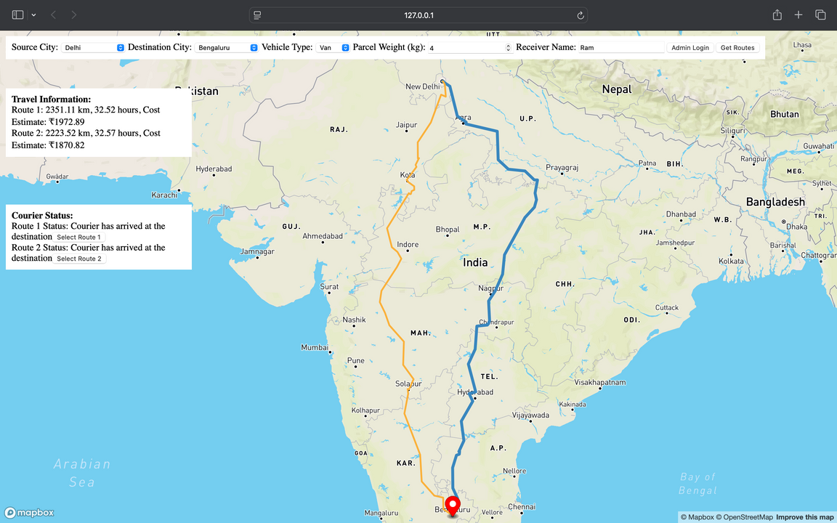
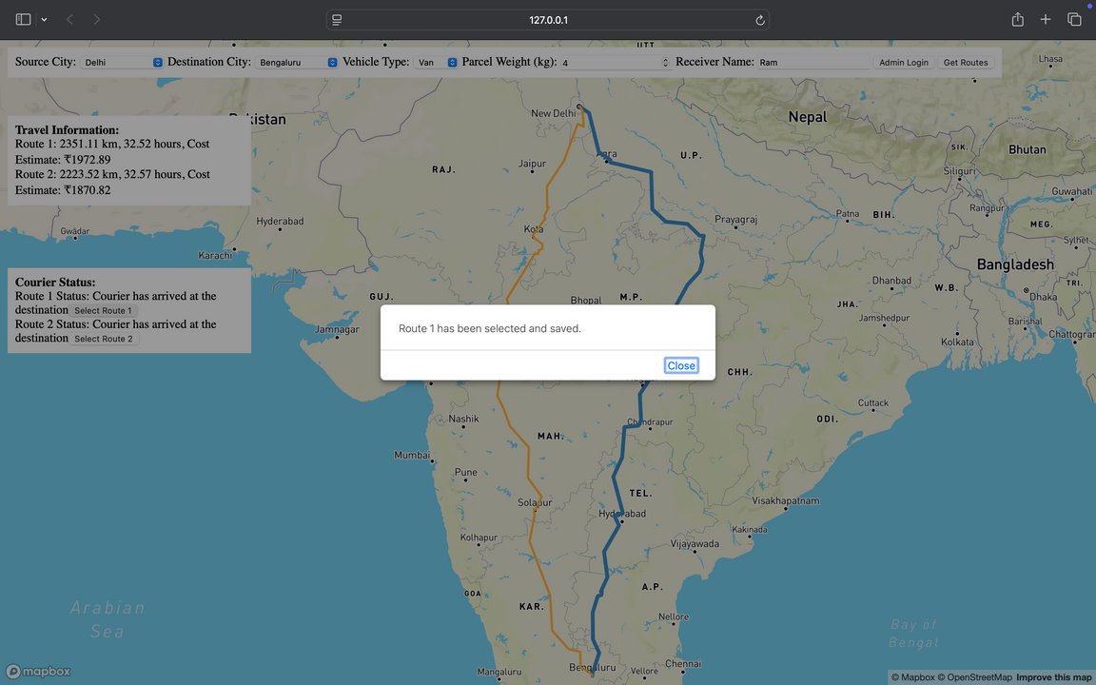
Implementation
Route Selection and Confirmation

Slide 16
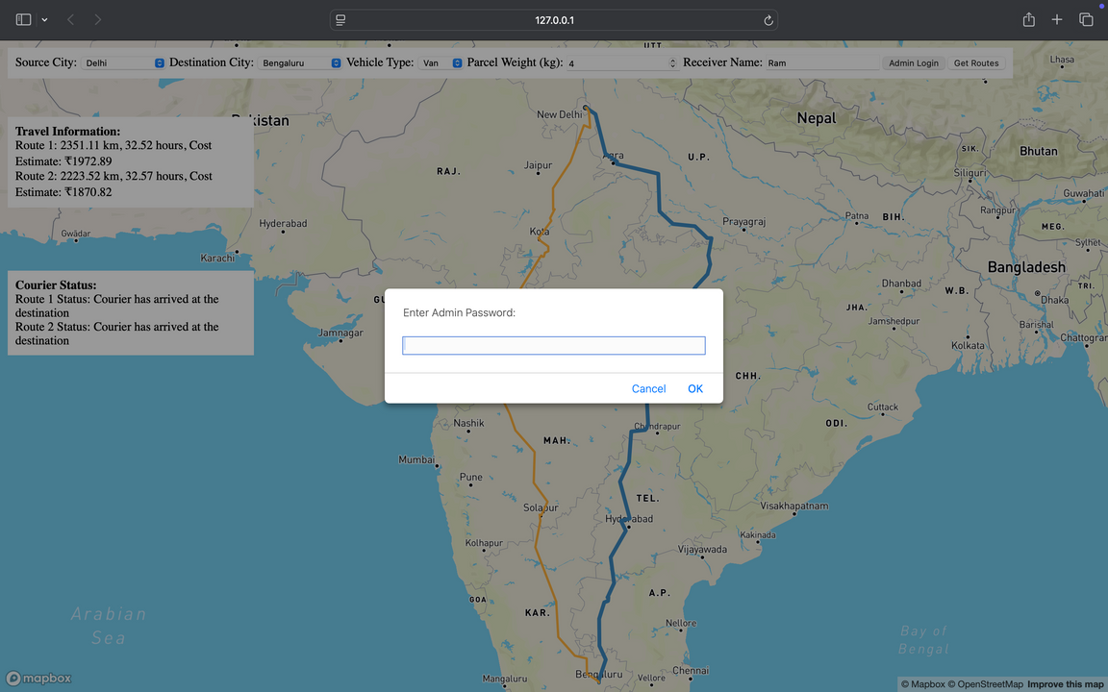
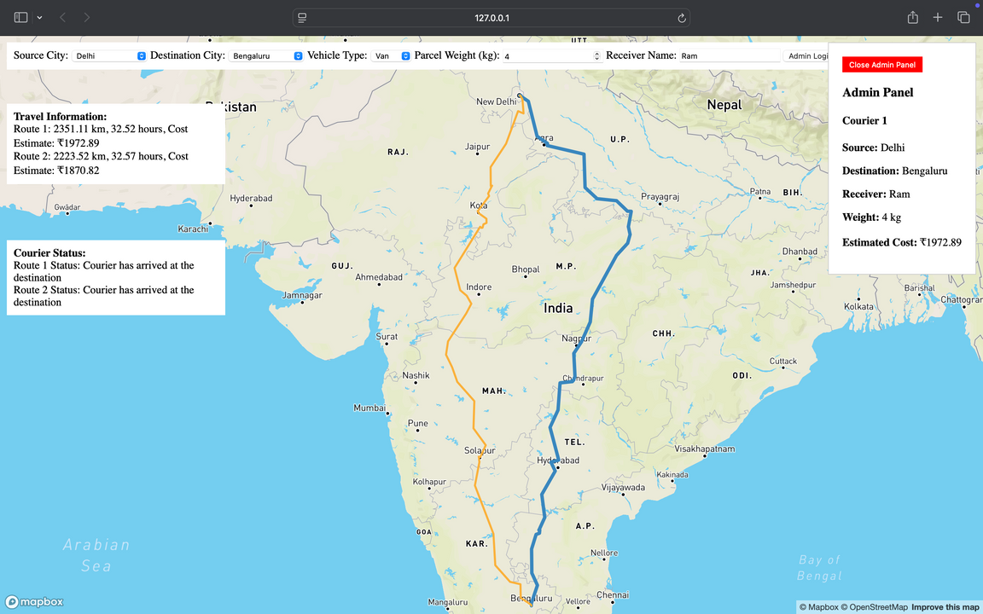
Implementation
Admin Login
Admin Panel

Slide 17
Conclusion
The "Quick Courier Service" project aims to make delivery faster and more efficient by calculating the best routes in real time. By showing users the quickest paths, it helps improve delivery speed and keeps customers happy. The interactive map and clear route details make it easy for users to understand. This service can greatly enhance the reliability of courier deliveries. Overall, the project addresses the growing needs of the logistics industry by simplifying the delivery process.

Slide 18
References
[1] Tasgaonkar, P. P., Garg, R. D., & Garg, P. K. (2024). GIS-Based optimum path analysis for tourist places in Haridwar City. Applied Geomatics, 1-9.
[2] Zhai, Y., Cui, J., Meng, F., Xie, H., Hou, C., & Li, B. (2024). Ship Path Planning Based on Sparse A* Algorithm. Journal of Marine Science and Application, 1-11.
[3] Surovtsev, R., & Dzerzhinsky, R. (2023). Study of Route-Finding Algorithms on the Transport System. In Proceedings of the Computational Methods in Systems and Software (pp. 43-48). Cham: Springer Nature Switzerland.
[4] Rasca, S. I., Hu, B., Biesinger, B., & Prandtstetter, M. (2024). Agent-based decision-support model for bus route redesign in networks of small cities and towns: case study of Agder, Norway. Public Transport, 1-36.
[5] Lin, S. (2022, December). Path Optimization of e-Commerce Logistics Terminal Distribution Mode Based on Dijkstra Algorithm. In International Conference on Big Data Analytics for Cyber-Physical System in Smart City (pp. 195-204). Singapore: Springer Nature Singapore.

Slide 19
References
[6] Wang, X. (2022, July). Design and Implementation of Intelligent Tourism System Based on Dijkstra Algorithm. In International Conference on Frontier Computing (pp. 1531-1537). Singapore: Springer Nature Singapore.
[7] Gayathri, R., Uma, V., & O’Brien, B. (2023, January). Implementing Robotic Path Planning After Object Detection in Deterministic Environments Using Deep Learning Techniques. In Machine Learning, Image Processing, Network Security and Data Sciences: Select Proceedings of 3rd International Conference on MIND 2021 (pp. 157-169). Singapore: Springer Nature Singapore.
[8] T. LaRock, M. Xu, and T. Eliassi-Rad, "A path-based approach to analyzing the global liner shipping network," 2022.LaRock, T., Xu, M., & Eliassi-Rad, T. (2022). A path-based approach to analyzing the global liner shipping network. EPJ Data Science, 11(1), 18.
[9] Yuan, J., Wan, J., Zhang, X., Xu, Y., Zeng, Y., & Ren, Y. (2022). A second-order dynamic and static ship path planning model based on reinforcement learning and heuristic search algorithms. EURASIP Journal on Wireless Communications and Networking, 2022(1), 128.

Slide 20
Thank You

